Slide 1

Spring of Code
Artificial Intelligence
(Machine Learning & Deep Learning)
Instructor
Asad Ullah
- Research Assistant (DIP Lab)
Duration
03 Months
(Feb – April)

Slide 2
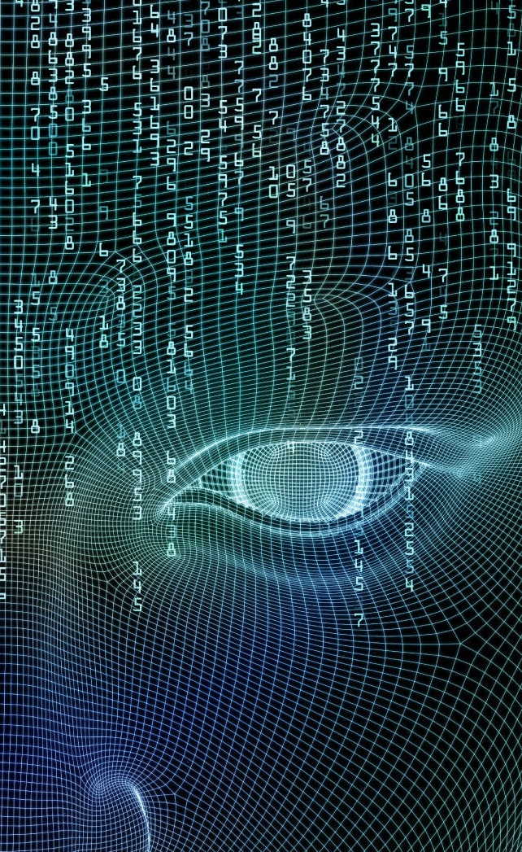
Day 01 – Deep Learning
(Convolutional Neural Networks)
Objectives:
Image Features
Convolution
Pooling
Convolutional Neural Networks

Slide 3
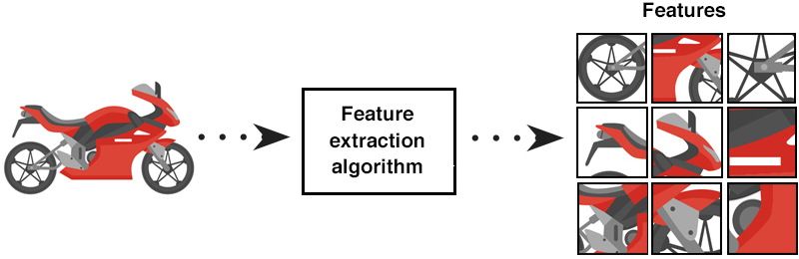
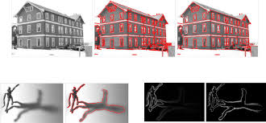
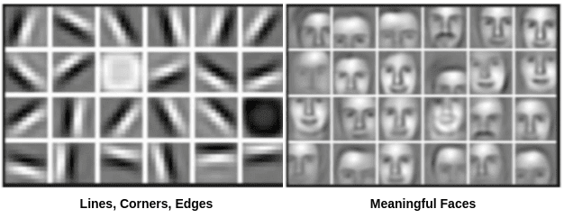
What Are Features in Images?
What makes this image recognizable?
Features are distinctive patterns or characteristics
Examples: edges, corners, textures, shapes, colors that help identify objects

Slide 4
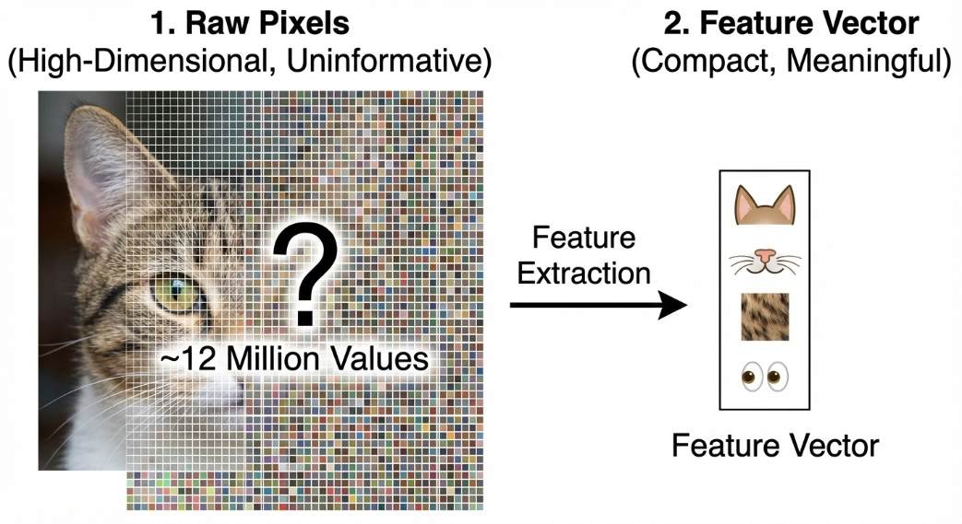
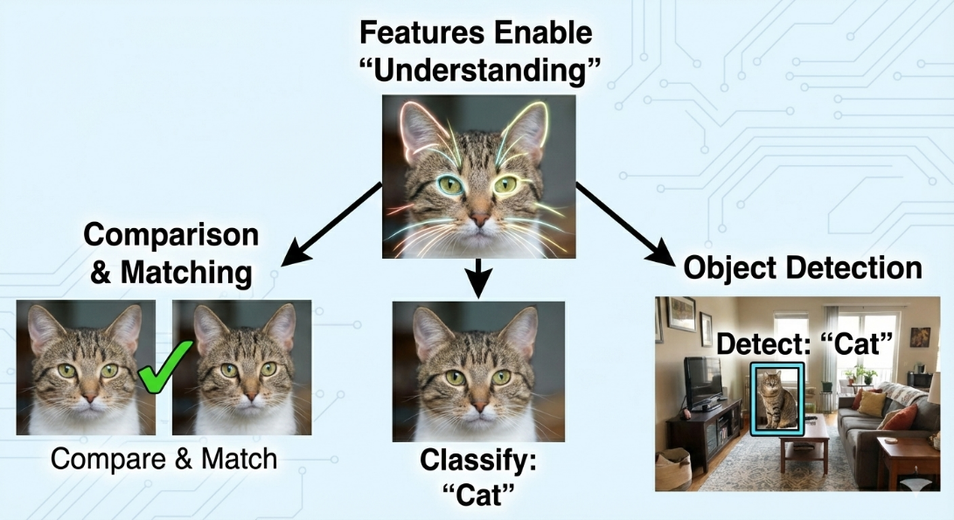
Why Do We Need Features?
Raw pixels are too high-dimensional and not informative
Features provide compact, meaningful representations
Enable computers to "understand" and compare images
Foundation for image classification, object detection, matching

Slide 5
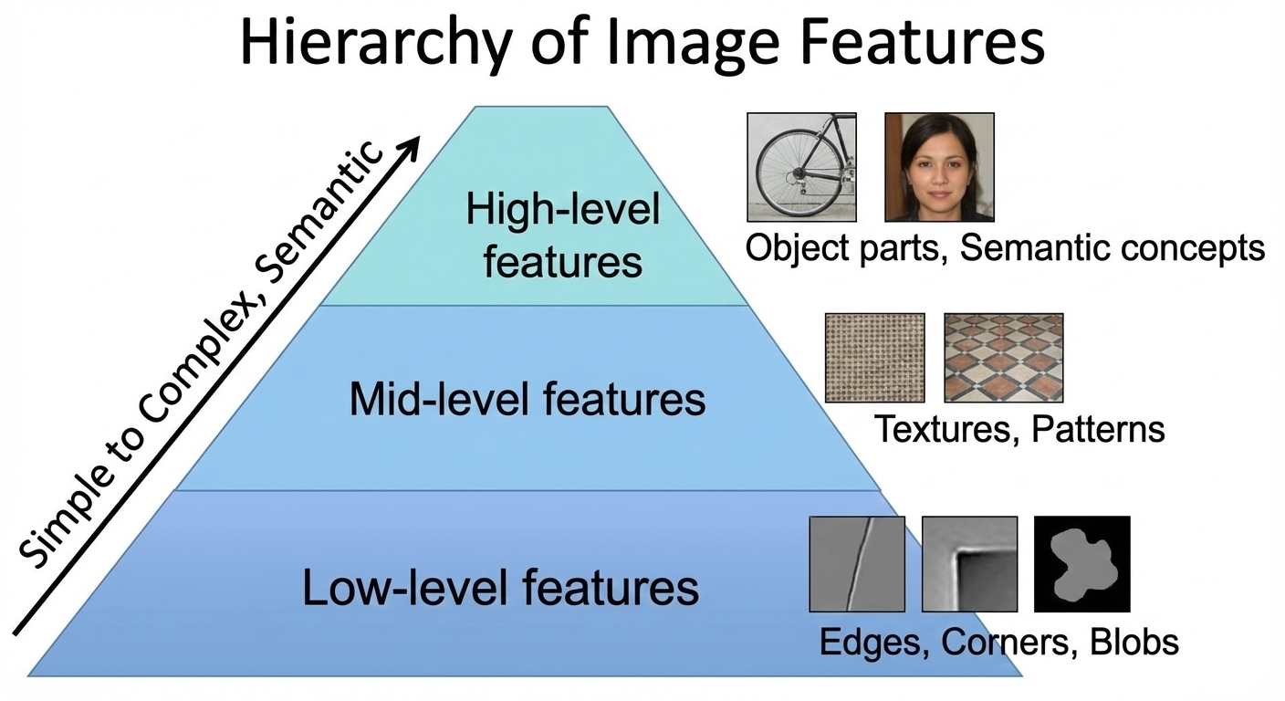
Types of Features
Low-level features: edges, corners, blobs
Mid-level features: textures, patterns
High-level features: object parts, semantic concepts

Slide 6
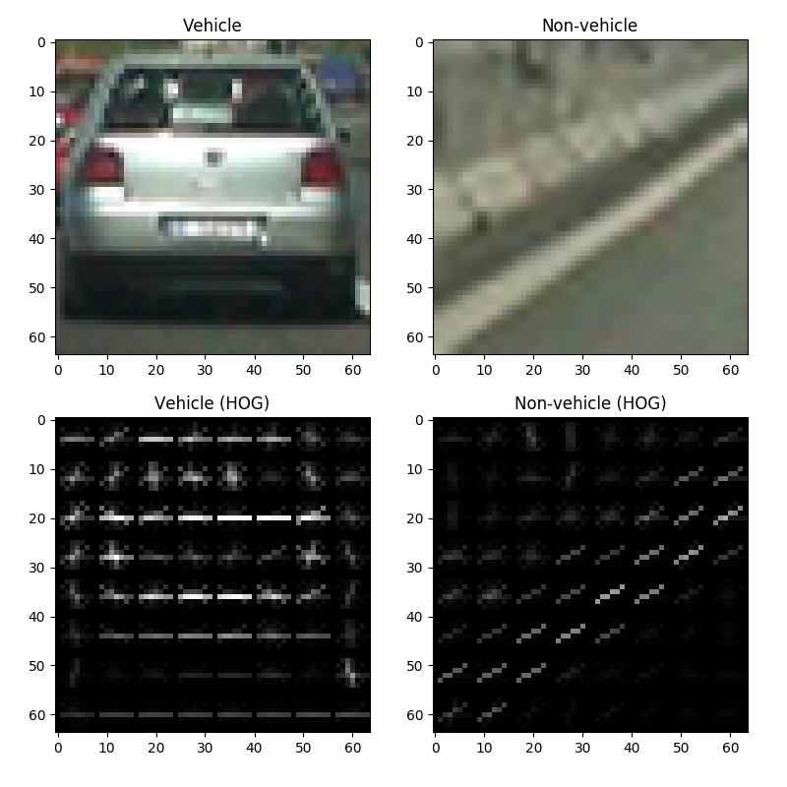
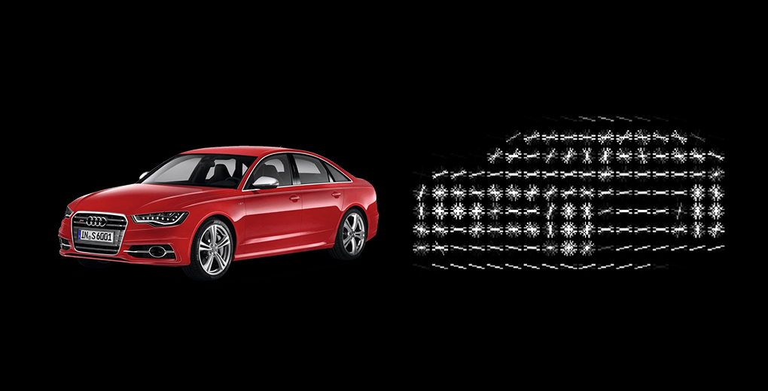
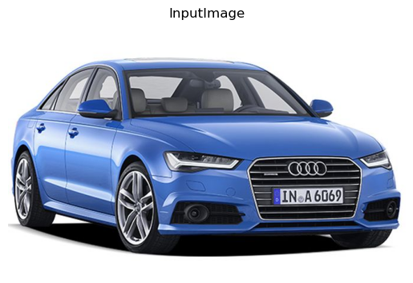
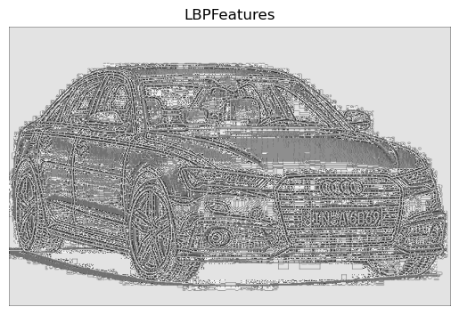

Slide 7
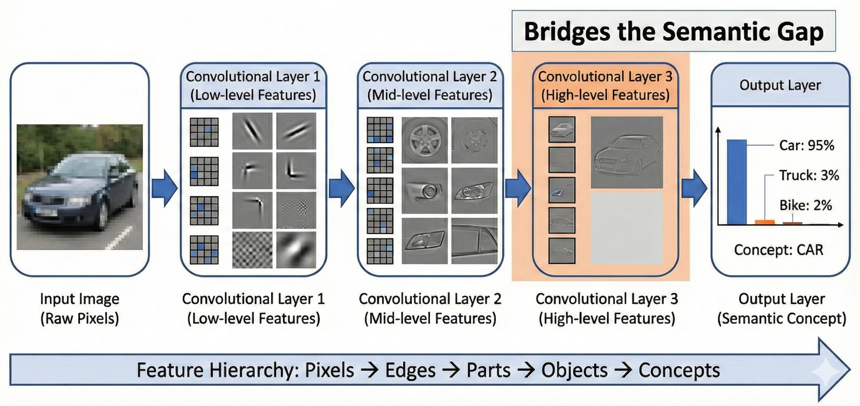
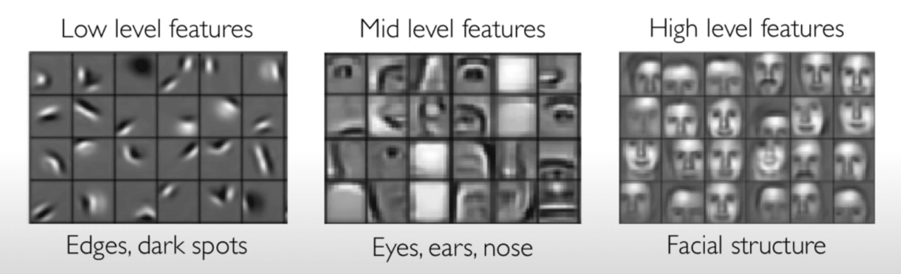
Enter Deep Learning - CNNs
Convolutional Neural Networks (CNNs)
Learn features automatically from data
Build hierarchical representations
Bridge the semantic gap
From pixels → edges → parts → objects → concepts

Slide 8
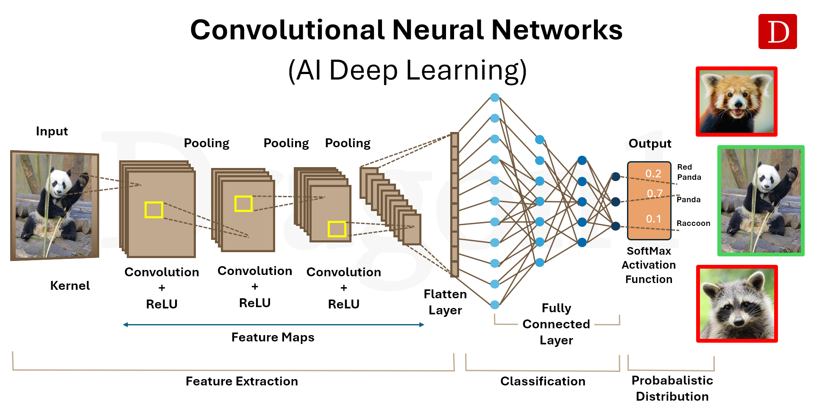
CNN Architecture Overview
Convolutional Layers: Learn spatial features
Pooling Layers: Reduce dimensionality
Activation Functions: Introduce non-linearity (ReLU)
Fully Connected Layers: Classification
Softmax: Output probabilities

Slide 9
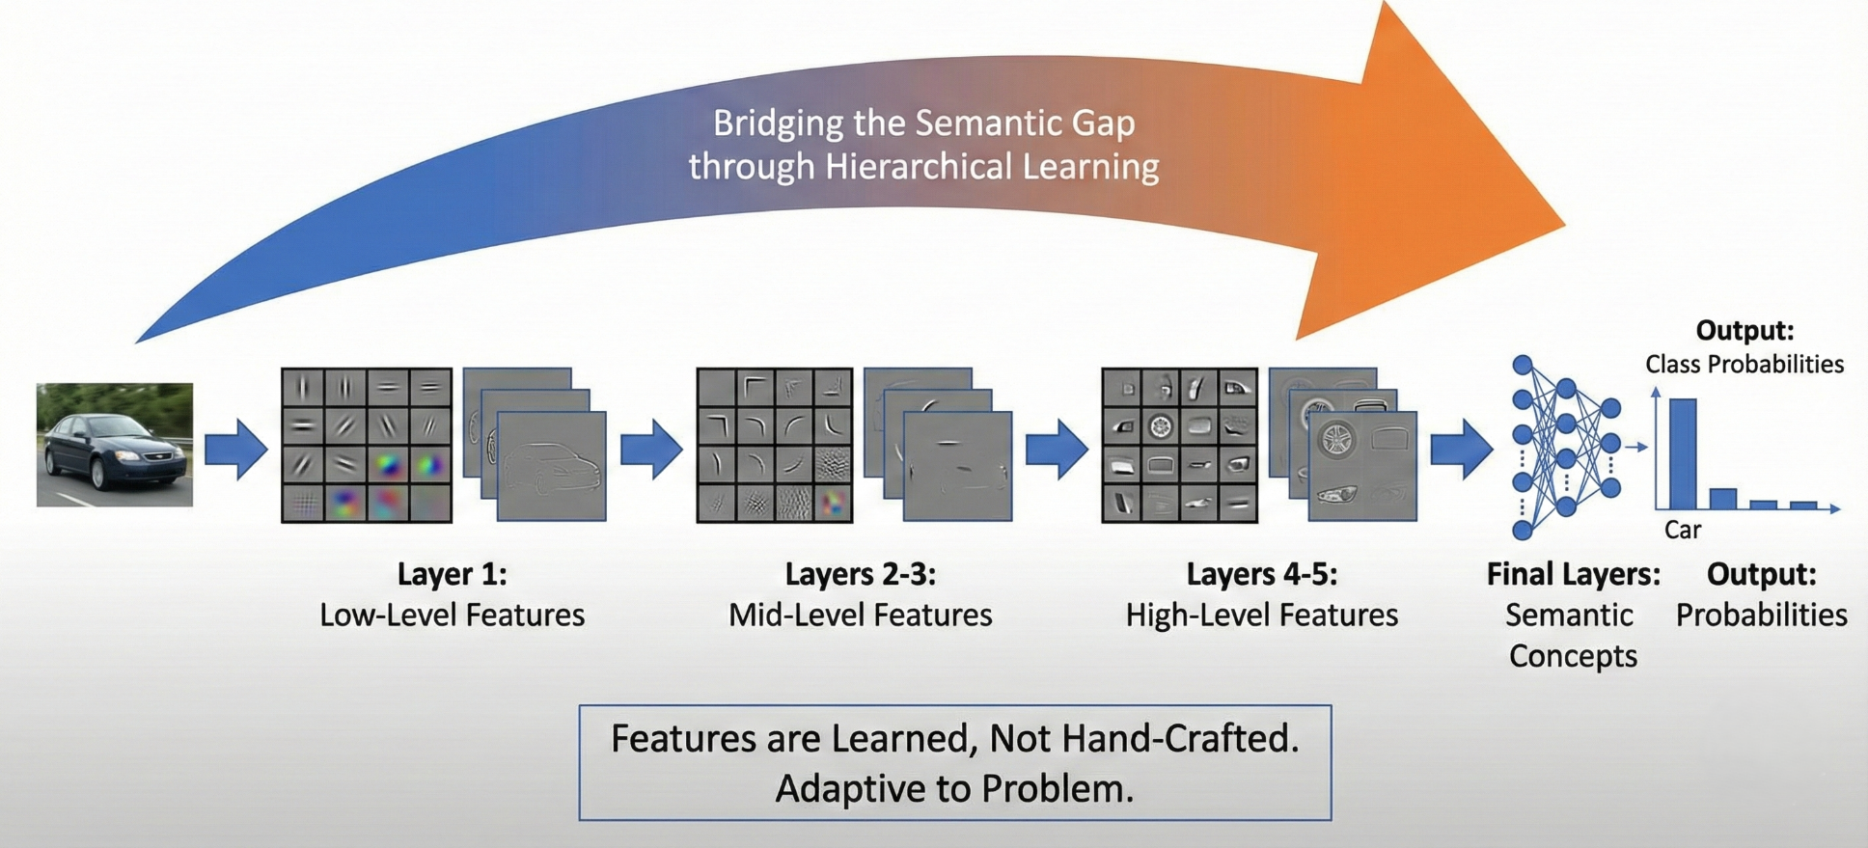
How CNNs Bridge the Semantic Gap
Layer 1: Low-level features (edges, colors)
Layer 2-3: Mid-level features (textures, patterns)
Layer 4-5: High-level features (object parts)
Final layers: Semantic concepts

Slide 10
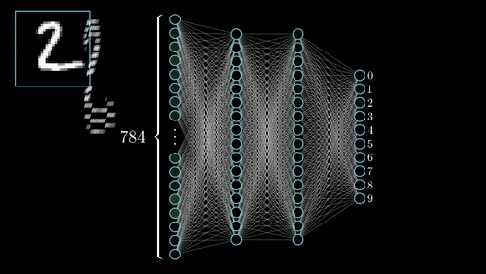
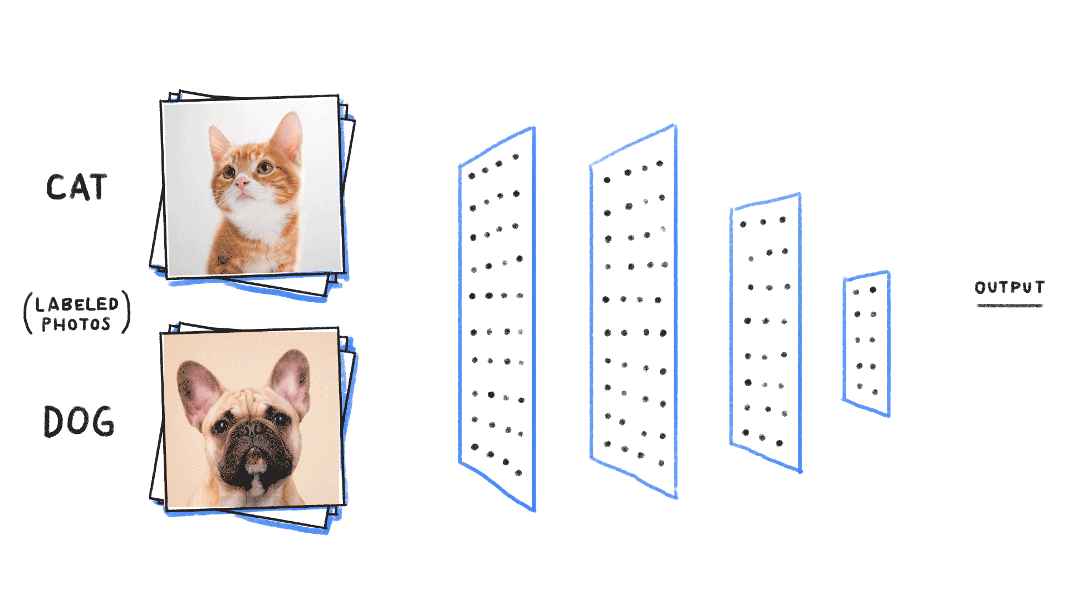
Convolutional vs Fully Connected Layers
Each neuron connected to a small range of input, instead of all the inputs.
Performs the convolution operation to extract features.
It has fewer parameters compared to fully connected layers because of weight sharing.
Primarily used for feature extraction
Notes:
- Scientific computing involves using computational methods to solve complex scientific and mathematical problems.
Numeric (1995):
First version was called "Numeric" or "Numerical Python"
Created by Jim Hugunin at MIT
Evolution to NumPy (2006):
Travis Oliphant led the creation of NumPy

Slide 11
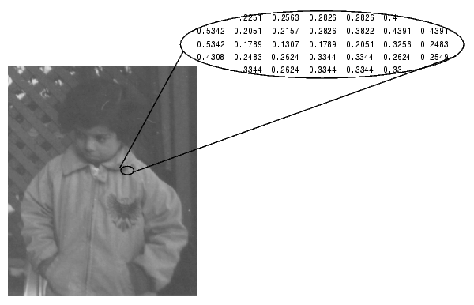
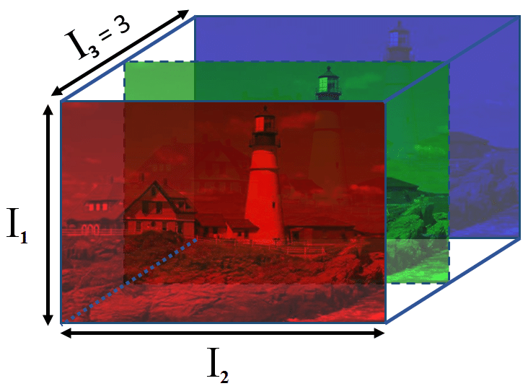
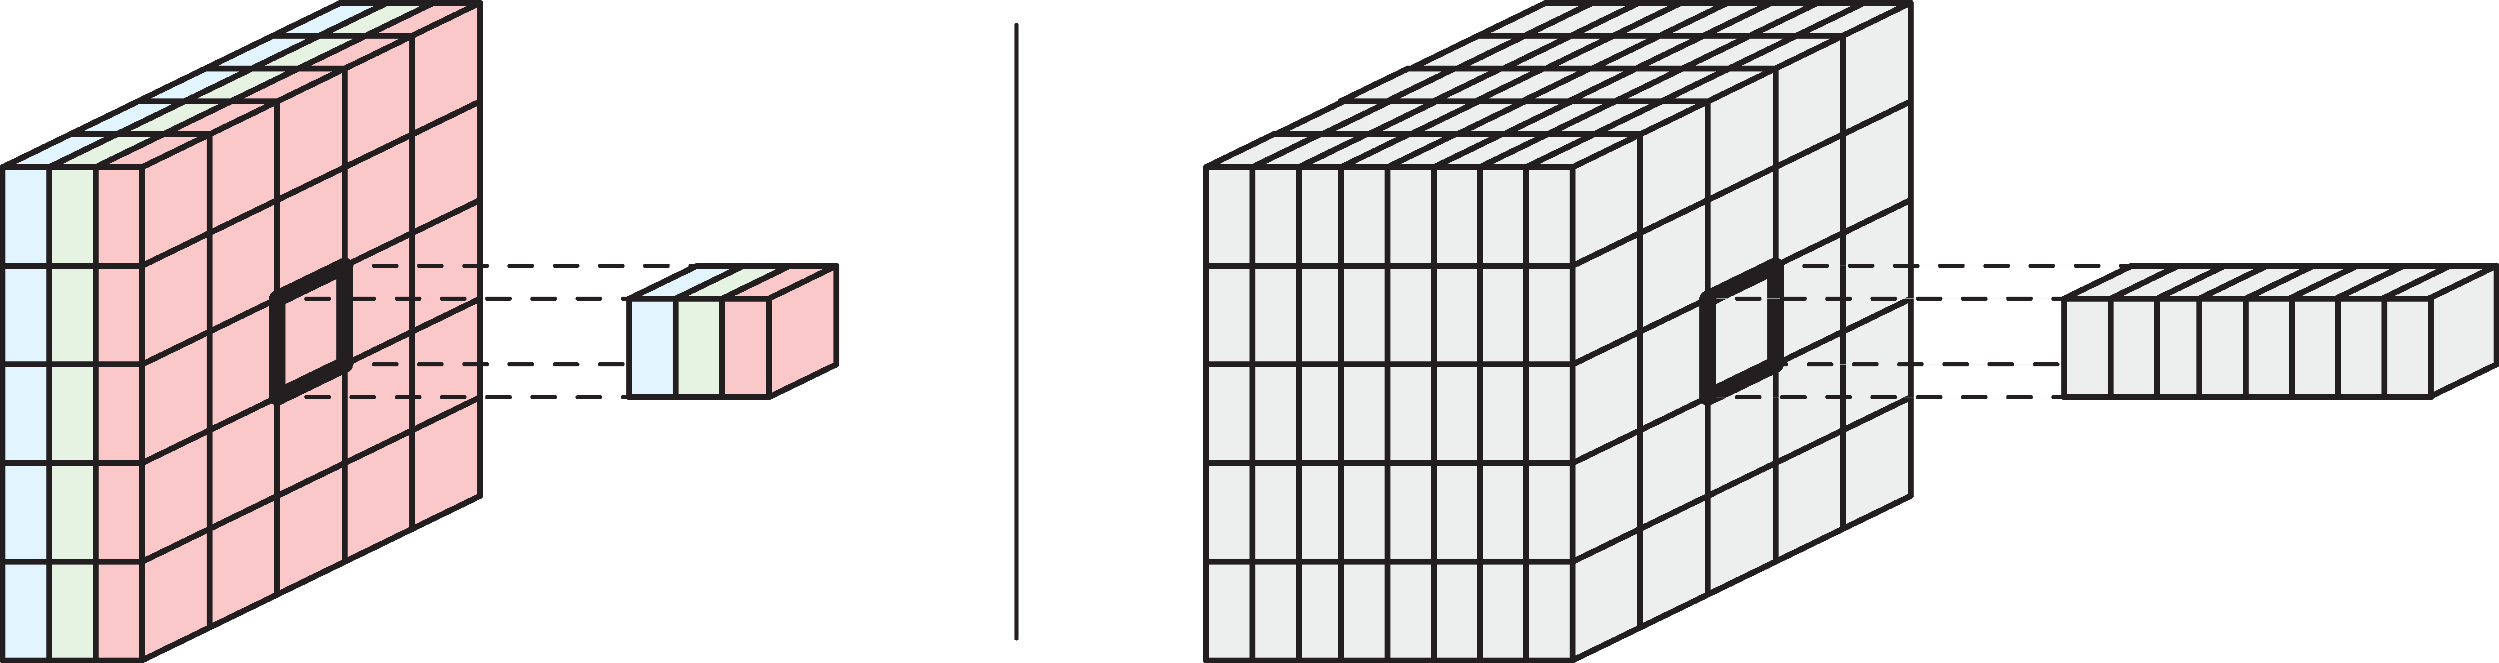
Images and Tensors
A digital image is a grid of pixel values, each pixel containing intensity information.
Grayscale images are represented as a 2D matrix of pixels (Height x Width), while color images have channels as well (Height, Width, Channels).
Tensors are generalization of matrices to higher dimensions.
Notes:
- Scientific computing involves using computational methods to solve complex scientific and mathematical problems.
Numeric (1995):
First version was called "Numeric" or "Numerical Python"
Created by Jim Hugunin at MIT
Evolution to NumPy (2006):
Travis Oliphant led the creation of NumPy

Slide 12
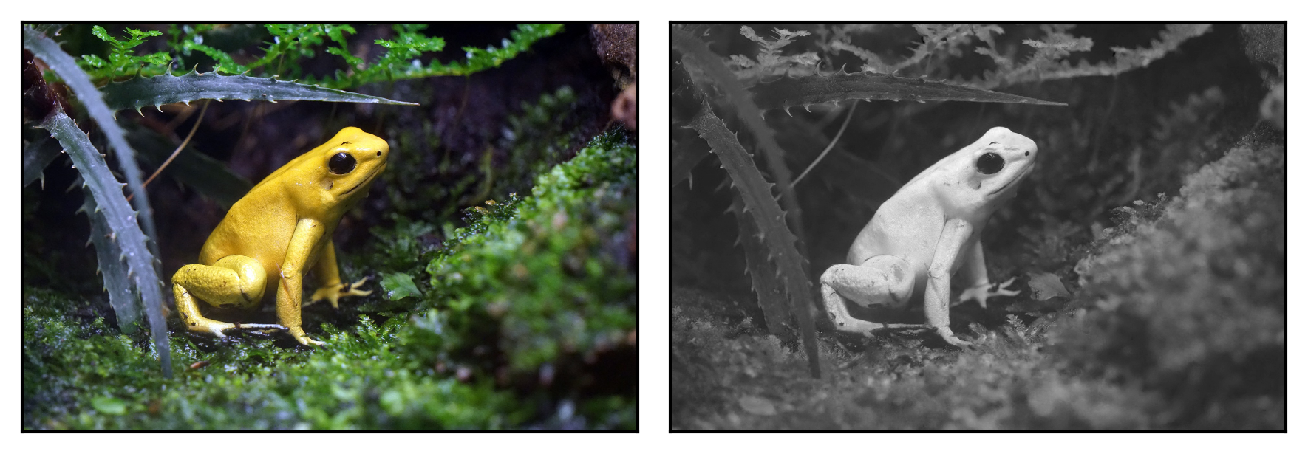
Convolution
Let’s say we want to detect the intensity of yellow color in each pixel
Notes:
- Scientific computing involves using computational methods to solve complex scientific and mathematical problems.
Numeric (1995):
First version was called "Numeric" or "Numerical Python"
Created by Jim Hugunin at MIT
Evolution to NumPy (2006):
Travis Oliphant led the creation of NumPy

Slide 13
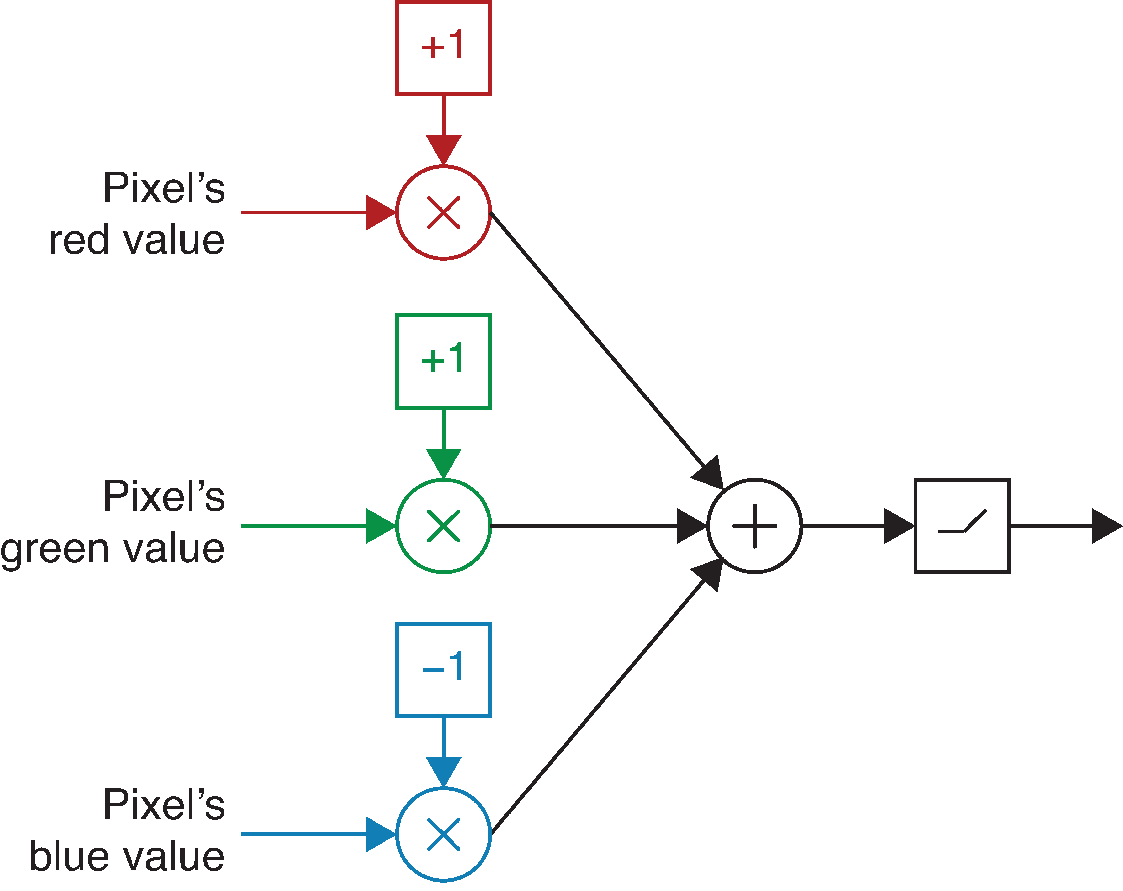
Convolution
We can create a yellow detector as an artificial neuron like so
Notes:
- Scientific computing involves using computational methods to solve complex scientific and mathematical problems.
Numeric (1995):
First version was called "Numeric" or "Numerical Python"
Created by Jim Hugunin at MIT
Evolution to NumPy (2006):
Travis Oliphant led the creation of NumPy

Slide 14
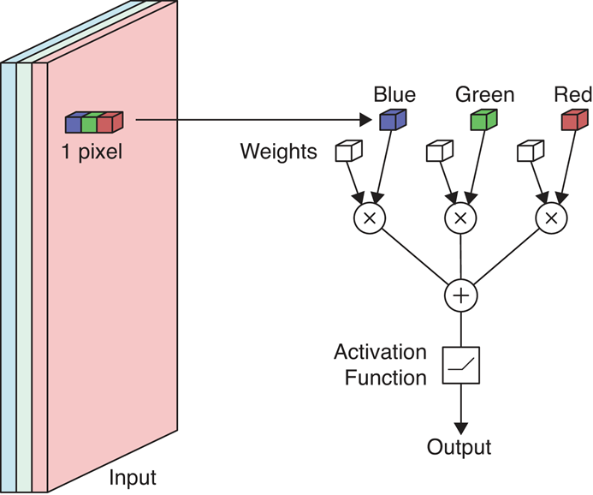
Convolution
We can apply the yellow detector to every pixel in the color input image
Notes:
- Scientific computing involves using computational methods to solve complex scientific and mathematical problems.
Numeric (1995):
First version was called "Numeric" or "Numerical Python"
Created by Jim Hugunin at MIT
Evolution to NumPy (2006):
Travis Oliphant led the creation of NumPy

Slide 15
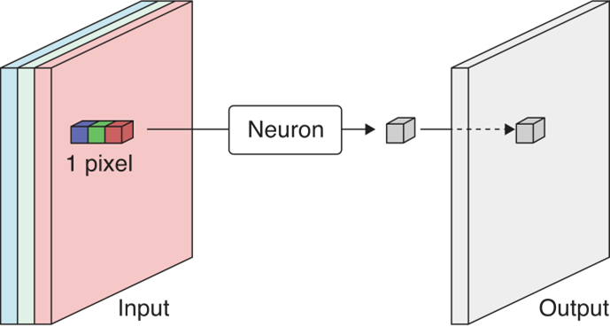
Convolution
As a result, we get a grayscale image where each pixel corresponds to the intensity of yellow color in the input image
Notes:
- Scientific computing involves using computational methods to solve complex scientific and mathematical problems.
Numeric (1995):
First version was called "Numeric" or "Numerical Python"
Created by Jim Hugunin at MIT
Evolution to NumPy (2006):
Travis Oliphant led the creation of NumPy

Slide 16
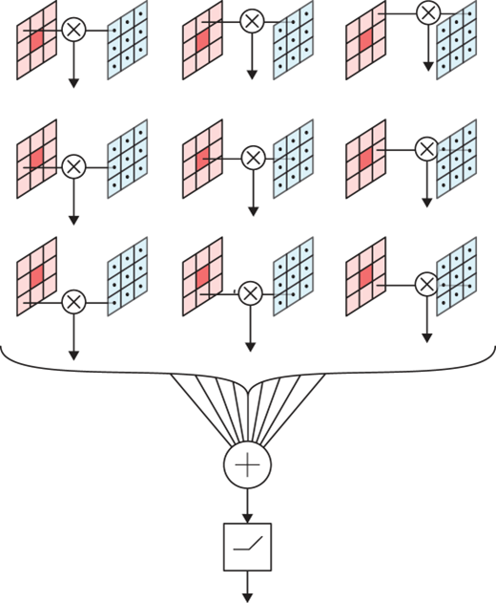
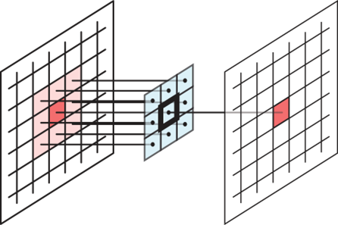
Convolution
Instead of processing a single pixel at a time, we can process a small region around the pixel
Input Image
Feature Map
Filter
Notes:
- Scientific computing involves using computational methods to solve complex scientific and mathematical problems.
Numeric (1995):
First version was called "Numeric" or "Numerical Python"
Created by Jim Hugunin at MIT
Evolution to NumPy (2006):
Travis Oliphant led the creation of NumPy

Slide 17
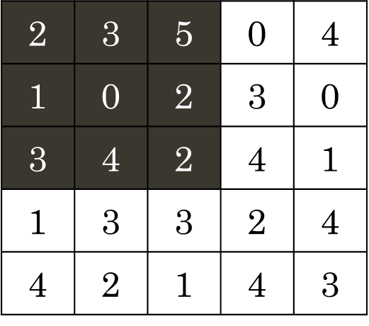
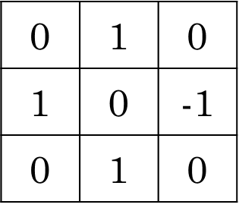
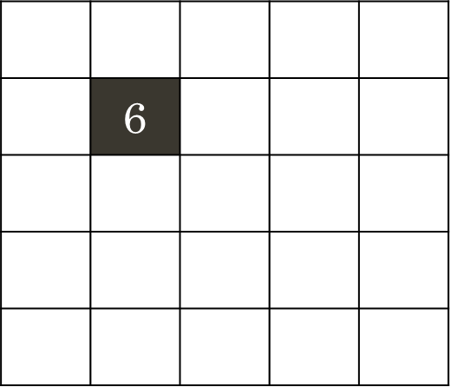
Example of Convolution Operation
*
Sum =
Input Image
Filter
Output Image

Slide 18
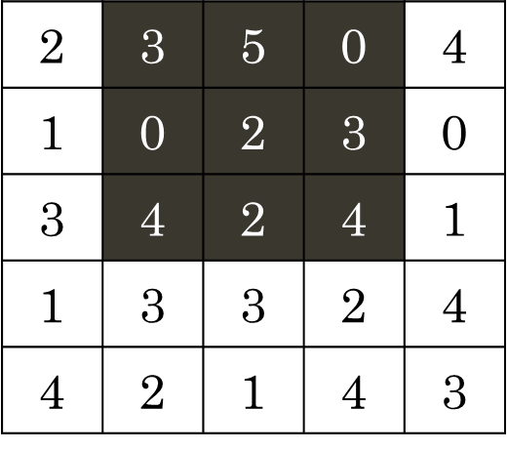
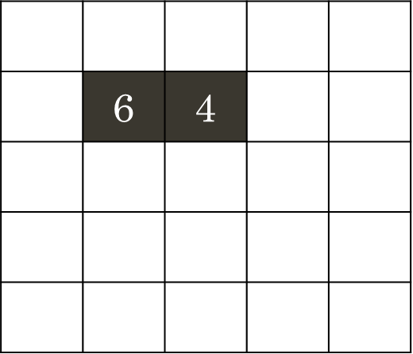
Example of Convolution Operation
*
Sum =
Input Image
Filter
Output Image

Slide 19
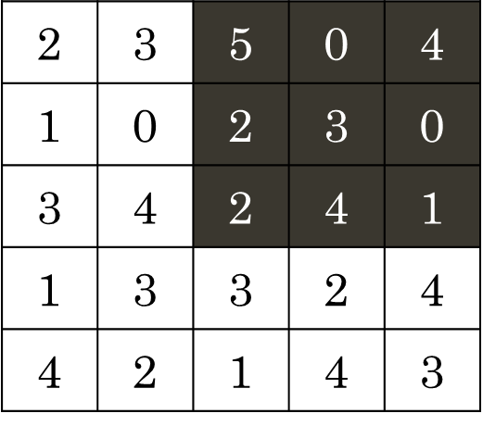
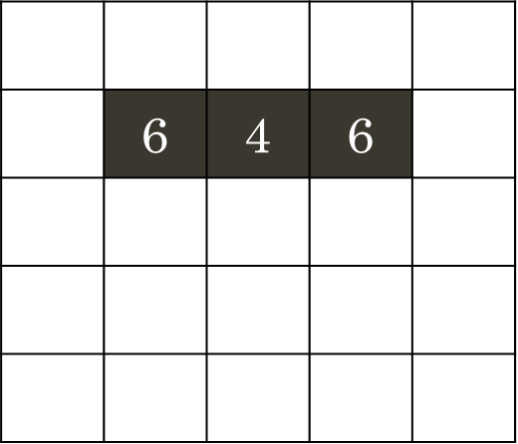
Example of Convolution Operation
*
Sum =
Input Image
Filter
Output Image

Slide 20
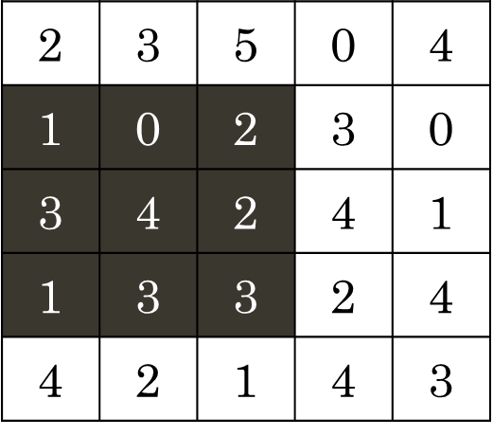
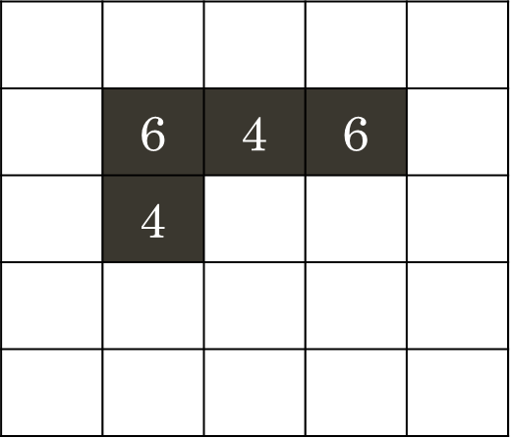
Example of Convolution Operation
*
Sum =
Input Image
Filter
Output Image

Slide 21
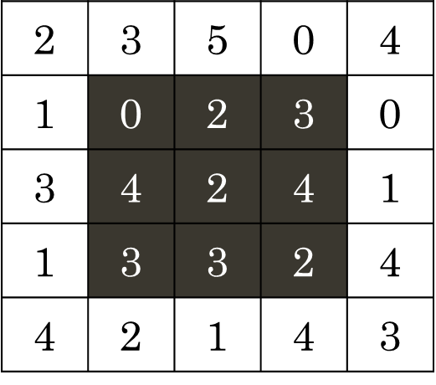
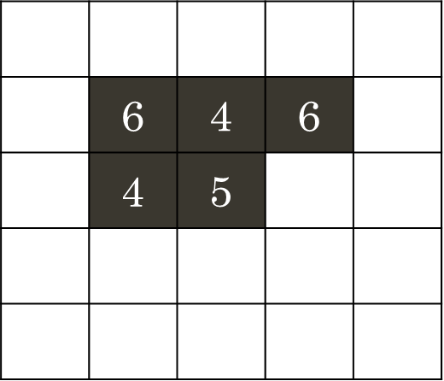
Example of Convolution Operation
*
Sum =
Input Image
Filter
Output Image

Slide 22
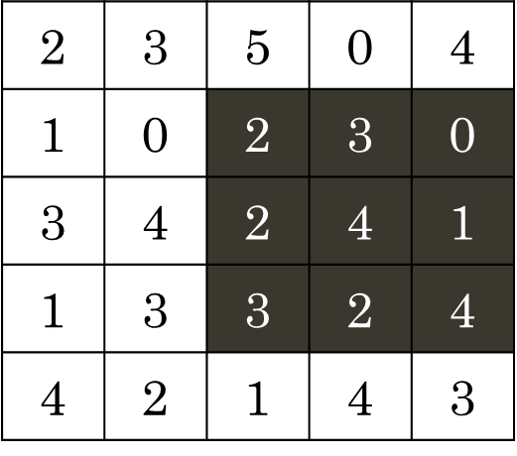
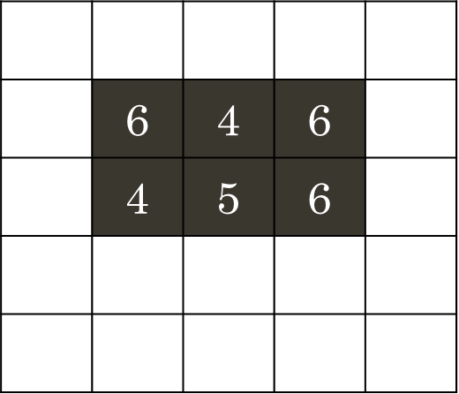
Example of Convolution Operation
*
Sum =
Input Image
Filter
Output Image

Slide 23
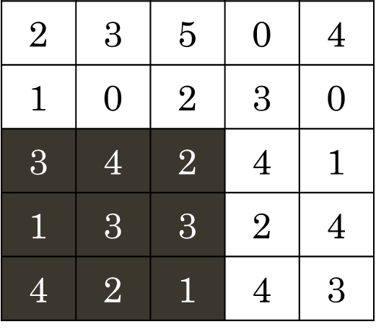
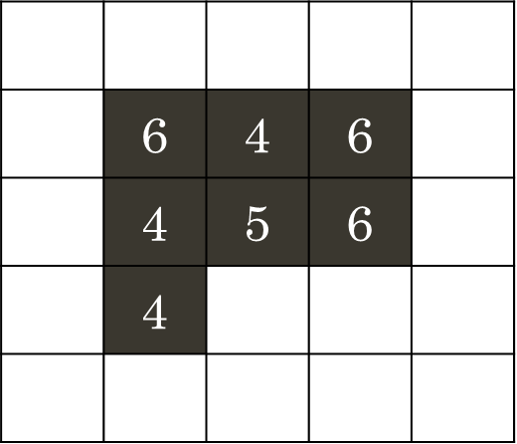
Example of Convolution Operation
*
Sum =
Input Image
Filter
Output Image

Slide 24
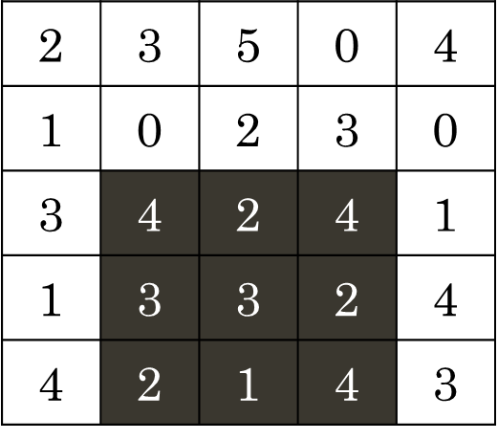
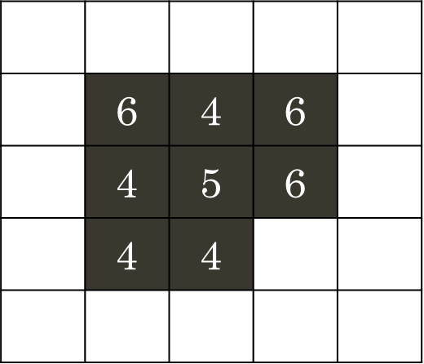
Example of Convolution Operation
*
Sum =
Input Image
Filter
Output Image

Slide 25
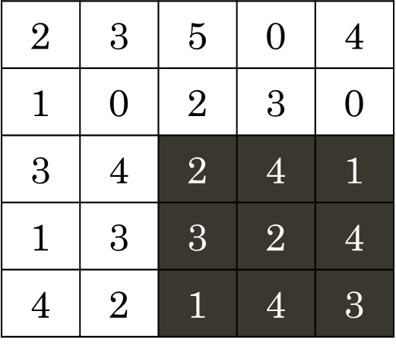
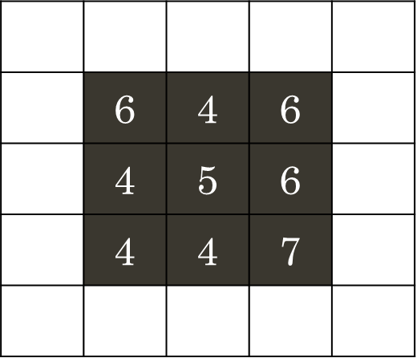
Example of Convolution Operation
*
Sum =
Input Image
Filter
Output Image

Slide 26
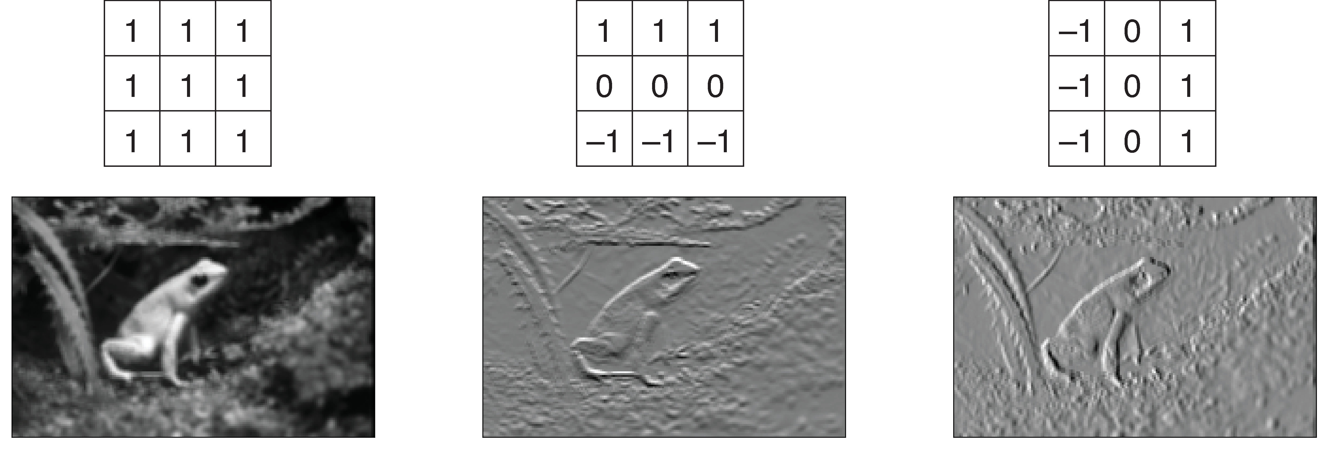
Convolution as Feature Extractor
We sweep the filter across the entire image to detect these different patterns as
Horizontal
Edges
Vertical
Edges
Blur
Notes:
- Scientific computing involves using computational methods to solve complex scientific and mathematical problems.
Numeric (1995):
First version was called "Numeric" or "Numerical Python"
Created by Jim Hugunin at MIT
Evolution to NumPy (2006):
Travis Oliphant led the creation of NumPy

Slide 27
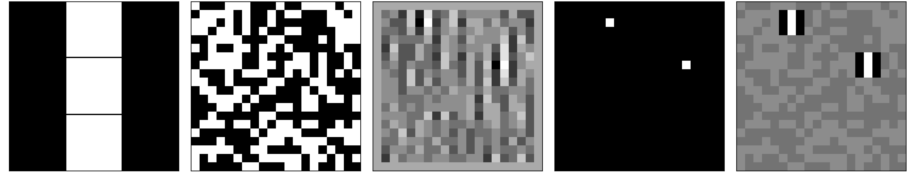
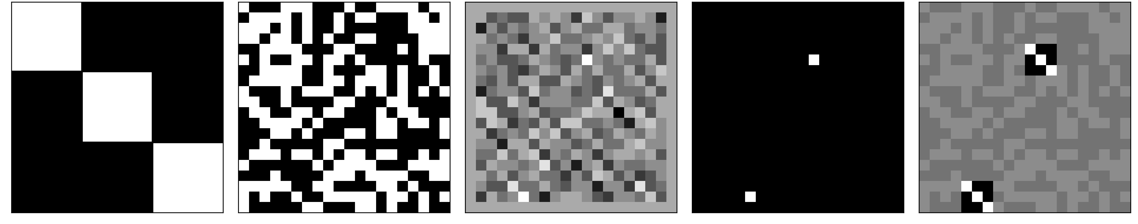
Convolution as Feature Extractor
This Process of sweeping the filter across the image and getting a feature map is called convolution
Feature
Map
Largest
Value
Filter
Image
Match
Notes:
- Scientific computing involves using computational methods to solve complex scientific and mathematical problems.
Numeric (1995):
First version was called "Numeric" or "Numerical Python"
Created by Jim Hugunin at MIT
Evolution to NumPy (2006):
Travis Oliphant led the creation of NumPy

Slide 28
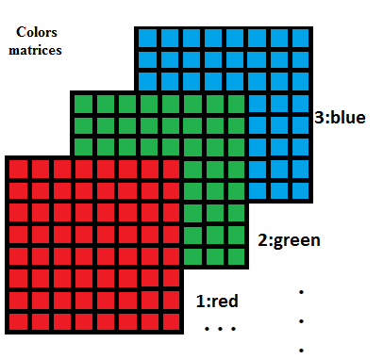
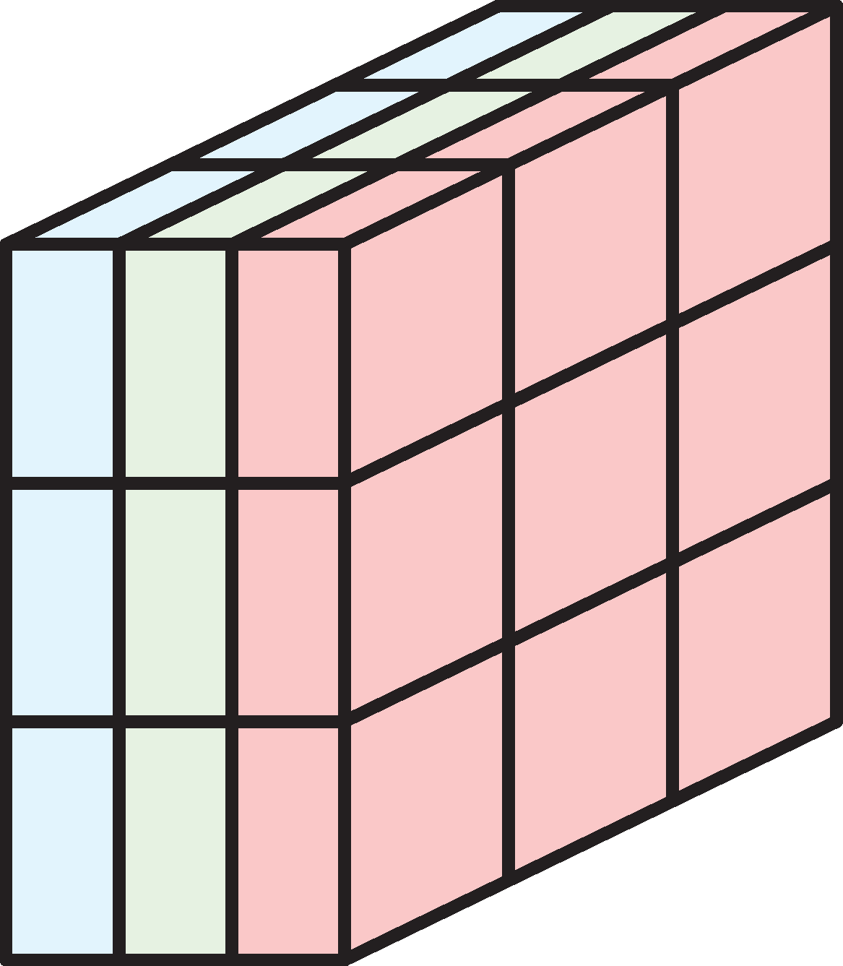
Multichannel Convolution
While performing convolution on input with more than one channel, our filter must also have the same number of channels
Filter with 3 channels
Color Image
Notes:
- Scientific computing involves using computational methods to solve complex scientific and mathematical problems.
Numeric (1995):
First version was called "Numeric" or "Numerical Python"
Created by Jim Hugunin at MIT
Evolution to NumPy (2006):
Travis Oliphant led the creation of NumPy

Slide 29

Multichannel Convolution
Each filter will then apply to the corresponding channel and results are added together
Filter with 3 channels
Color
Image
Notes:
- Scientific computing involves using computational methods to solve complex scientific and mathematical problems.
Numeric (1995):
First version was called "Numeric" or "Numerical Python"
Created by Jim Hugunin at MIT
Evolution to NumPy (2006):
Travis Oliphant led the creation of NumPy

Slide 30
Padding in Convolution
What is padding?
Why we use padding in Convolution?
In the figure shown, part of the filter 'w' lies outside the image 'f' when processing the edge pixels. As a result, the sum of the products is undefined in that area.
In the figure shown, the size of the output decreased when we didn’t process the edge pixels.
Padding ensures that the filter can be applied evenly across all pixels.
1 | 0 | -1
1 | 0 | -1
1 | 0 | -1
0 | 4 | 1 | 3 | 0
1 | 3 | 1 | 0 | 2
4 | 0 | 2 | 4 | 3
2 | 0 | 0 | 1 | 4
0 | 3 | 1 | 2 | 0
0 | 4 | 1 | 3 | 0
1 | 3 | 1 | 0 | 2
4 | 0 | 2 | 4 | 3
2 | 0 | 0 | 1 | 4
0 | 3 | 1 | 2 | 0
1
0
-1
1 | 0 | -1
1 | 0 | -1
1 | 0 | -1
4
-2
-6
3
-4
-4
w
f (no padding)

Slide 31
Padding in Convolution
1 | 2 | 3
4 | 5 | 6
7 | 8 | 9
1 | 0 | -1
1 | 0 | -1
1 | 0 | -1
Zero Padding
  Zero padding adds zeros around the image border to maintain the same size after filtering.
  Use cases: Commonly used in deep learning to ensure output feature maps match input dimensions, especially in multi-layer networks.
Replicate Padding
  Replicate padding copies border pixel values as padding to preserve edge information.
  Use cases: Useful in smoothing filters (e.g., Gaussian blur) to avoid artificial edges from zero padding.
w
f (no padding)
0 | 0 | 0 | 0 | 0
0 | 1 | 2 | 3 | 0
0 | 4 | 5 | 6 | 0
0 | 7 | 8 | 9 | 0
0 | 0 | 0 | 0 | 0
Zero Padding
1 | 1 | 2 | 3 | 3
1 | 1 | 2 | 3 | 3
4 | 4 | 5 | 6 | 6
7 | 7 | 8 | 9 | 9
7 | 7 | 8 | 9 | 9
Replicate Padding

Slide 32
Convolutional Layer
We bundle up multiple filters together, each looking for a different pattern, forming a convolutional layer
Filter 1
Filter 2
Filter 3
Filter 4
Output of Conv Layer
Feature map 2
Feature map 3
Feature map 1
Feature map 4
Notes:
- Scientific computing involves using computational methods to solve complex scientific and mathematical problems.
Numeric (1995):
First version was called "Numeric" or "Numerical Python"
Created by Jim Hugunin at MIT
Evolution to NumPy (2006):
Travis Oliphant led the creation of NumPy

Slide 33

Convolutional Layer
A convolutional layer can have many filters, but each one will produce a single feature map
Filter 1
Feature map 1
Filter 2
Feature map 2
Output of Conv Layer
As many feature maps as there are filters
Filter 3
Feature map 3
Input
Feature Maps
Feature map 4
Filter 4
Notes:
- Scientific computing involves using computational methods to solve complex scientific and mathematical problems.
Numeric (1995):
First version was called "Numeric" or "Numerical Python"
Created by Jim Hugunin at MIT
Evolution to NumPy (2006):
Travis Oliphant led the creation of NumPy

Slide 34

Pooling Layer
Pooling frees our filters to be precisely in the right place and also reduce the feature map size
Notes:
- Scientific computing involves using computational methods to solve complex scientific and mathematical problems.
Numeric (1995):
First version was called "Numeric" or "Numerical Python"
Created by Jim Hugunin at MIT
Evolution to NumPy (2006):
Travis Oliphant led the creation of NumPy

Slide 35

Striding
Instead of sweeping our filters over one pixel at a time, we can move more than one pixel
Moving 3 pixels while moving to the right
Stride = 2
Center Filter over every other pixel
Stride = 3
Center Filter over every third pixel
Moving 2 pixels while moving down
Notes:
- Scientific computing involves using computational methods to solve complex scientific and mathematical problems.
Numeric (1995):
First version was called "Numeric" or "Numerical Python"
Created by Jim Hugunin at MIT
Evolution to NumPy (2006):
Travis Oliphant led the creation of NumPy

Slide 36


Striding
Instead of sweeping our filters over one pixel at a time, we can move more than one pixel
Stride = 2
Center Filter over every other pixel
Stride = 3
Center Filter over every third pixel
Notes:
- Scientific computing involves using computational methods to solve complex scientific and mathematical problems.
Numeric (1995):
First version was called "Numeric" or "Numerical Python"
Created by Jim Hugunin at MIT
Evolution to NumPy (2006):
Travis Oliphant led the creation of NumPy

Slide 37


Convnets in Practice
Convolutional Neural Networks (CNNs) are made of convolutional layers and pooling layers (along with others)
LeNet Architecture
VGG16 Architecture
Notes:
- Scientific computing involves using computational methods to solve complex scientific and mathematical problems.
Numeric (1995):
First version was called "Numeric" or "Numerical Python"
Created by Jim Hugunin at MIT
Evolution to NumPy (2006):
Travis Oliphant led the creation of NumPy

Slide 38


Visualizing Feature Maps
Let’s visualize the feature maps obtained from various CNN blocks of VGG16
Input Image
Feature map of a single filter
Notes:
- Scientific computing involves using computational methods to solve complex scientific and mathematical problems.
Numeric (1995):
First version was called "Numeric" or "Numerical Python"
Created by Jim Hugunin at MIT
Evolution to NumPy (2006):
Travis Oliphant led the creation of NumPy

Slide 39

Visualizing Feature Maps
Let’s visualize the feature maps obtained from various CNN blocks of VGG16
Input Image
Notes:
- Scientific computing involves using computational methods to solve complex scientific and mathematical problems.
Numeric (1995):
First version was called "Numeric" or "Numerical Python"
Created by Jim Hugunin at MIT
Evolution to NumPy (2006):
Travis Oliphant led the creation of NumPy

Slide 40

Visualizing Feature Maps
Let’s visualize the feature maps obtained from various CNN blocks of VGG16
Input Image
Notes:
- Scientific computing involves using computational methods to solve complex scientific and mathematical problems.
Numeric (1995):
First version was called "Numeric" or "Numerical Python"
Created by Jim Hugunin at MIT
Evolution to NumPy (2006):
Travis Oliphant led the creation of NumPy

Slide 41

Visualizing Feature Maps
Let’s visualize the feature maps obtained from various CNN blocks of VGG16
Input Image
Notes:
- Scientific computing involves using computational methods to solve complex scientific and mathematical problems.
Numeric (1995):
First version was called "Numeric" or "Numerical Python"
Created by Jim Hugunin at MIT
Evolution to NumPy (2006):
Travis Oliphant led the creation of NumPy

Slide 42
Thank You

